Slide 1
AI in healthcare: Artificial Intelligence or Superficial Stupidity?
Dr. David Wong
@drdavecwong

Slide 2
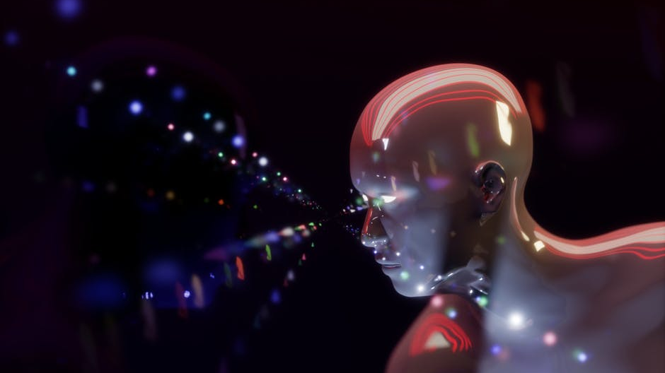
Startups labelled as being in AI attract 15% to 50% more funding than other technology firms.
MMC Ventures. The Staet of AI: Divergence, 2019

Slide 3
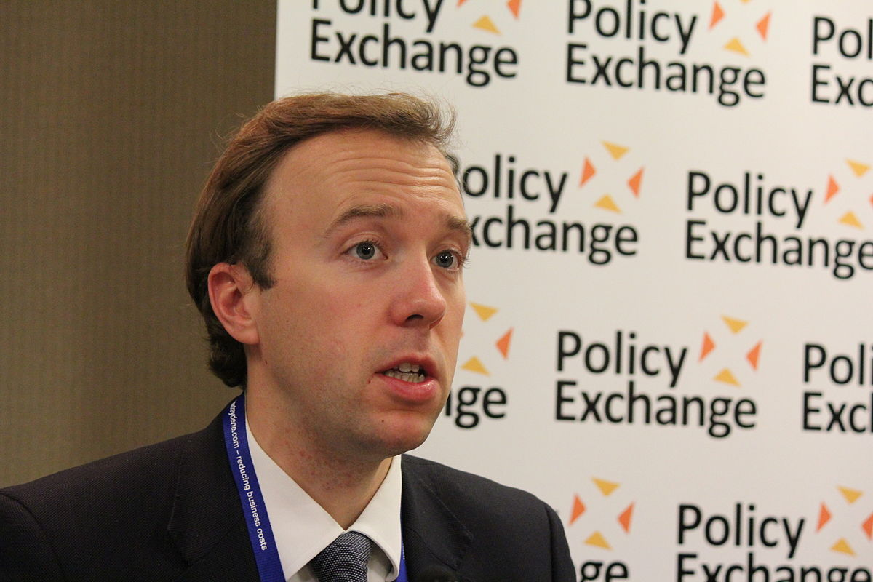
So if you don’t like change much then I don’t have good news for you and that’s down to the nature of data technologies, and especially AI. For while old-fashioned consumption is a one off: once you’ve eaten the apple, you don’t have the apple and standard investment is additive: build a bridge and you’ve got a bridge development of artificial intelligence is compound: the system stays with you, and it learns and gets better over time.
This Photo by Unknown Author is licensed under CC BY-SA

Slide 4
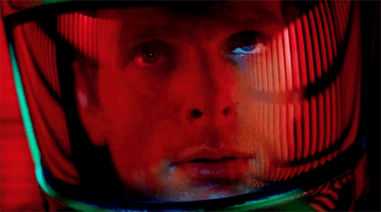

Slide 5
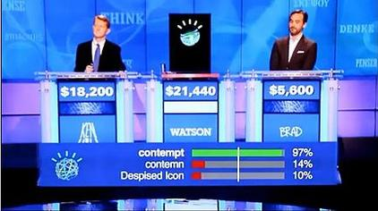
AI in real life
Jeopardy
This Photo by Unknown Author is licensed under CC BY-SA

Slide 6
This Photo by Unknown Author is licensed under CC BY-SA

Slide 7
Noughts and Crosses

Slide 8
Noughts and Crosses (playing as X)
1.) Go in a corner
2.) Go in the opposite corner. If the other player went there, go in any other corner
3.) If there are two Xs and a space in a line (in any order) go in that space. Otherwise, if there are two Os and a space in a line, go in that space. Otherwise go in a free corner.
4.) Same as 3
5.) Go in the free space

Slide 9
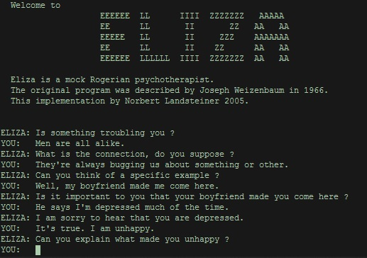
Eliza the psychotherapist
Virtual

Slide 10
Modern AI – Supervised Learning
Inputs and Output Labels
Input: pictures, Output Label: type of animal
Input: data from hospital record, Output Label: dead or alive
Input: football teams, players, Output Label: match score
Get LOTS of historical inputs and outputs.
For a new INPUT, what our best guess of the OUTPUT?
data
data
data
AI Engine
Output Label

Slide 11
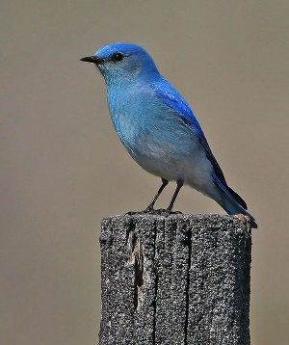
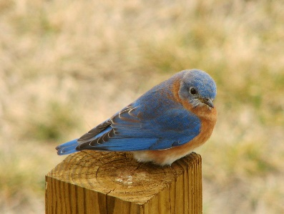
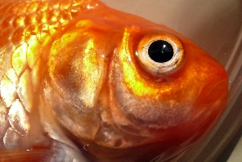
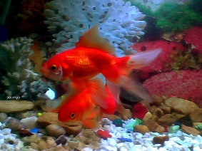
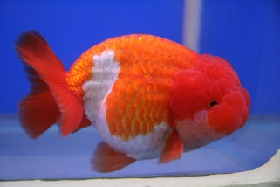
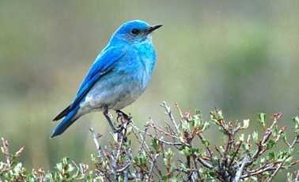
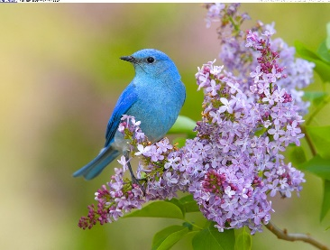
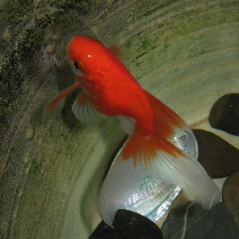
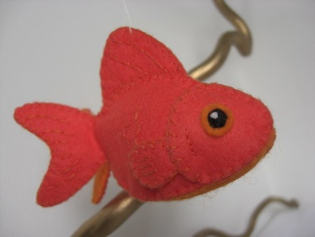
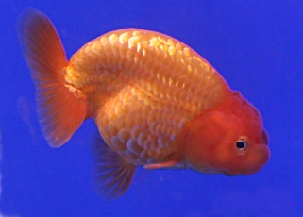
Supervised learning for pictures
Average Colour

Slide 12
Supervised learning for pictures
Average Colour

Slide 13
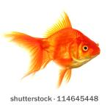
Supervised learning for pictures
Average Colour

Slide 14
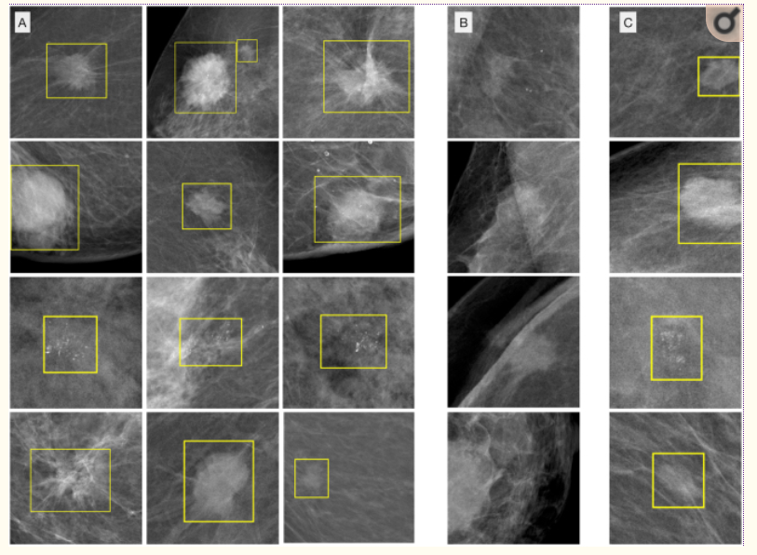
results
90% of malignant lesions (malignant or benign)
0.3 false positive marks per image
False positives are mainly benign masses or calcifications

Slide 15
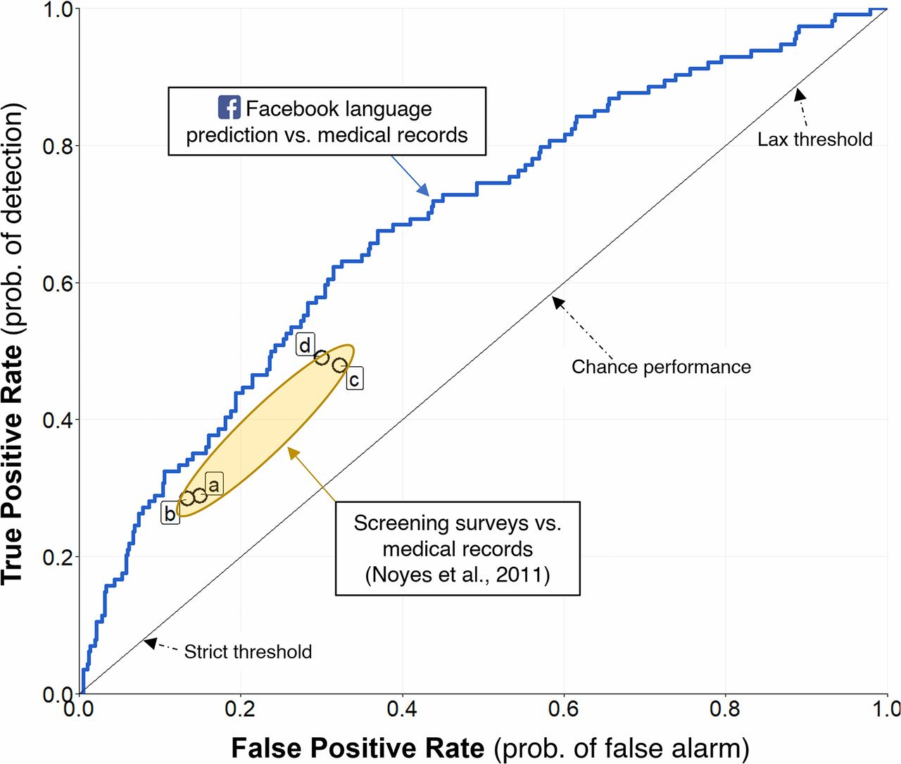
OTHER EXAMPLES FROM HEALTHCARE
CARDIOLOGY [1]
Diagnosing heart attack (output) in ECGs (input)
Comparable performance to cardiologists
MENTAL HEALTH [2]
Predicting depression (output) from facebook posts
Comparable to self-report depression scales (may be better)
1. Strodthoff et al. Detecting and interpreting myocardial infarctions using fully convolutional neural networks
2. Eichstaedt et al. Facebook language predicts depressing in medical records

Slide 16
problems

Slide 17
Problems - extrapolation

Slide 18
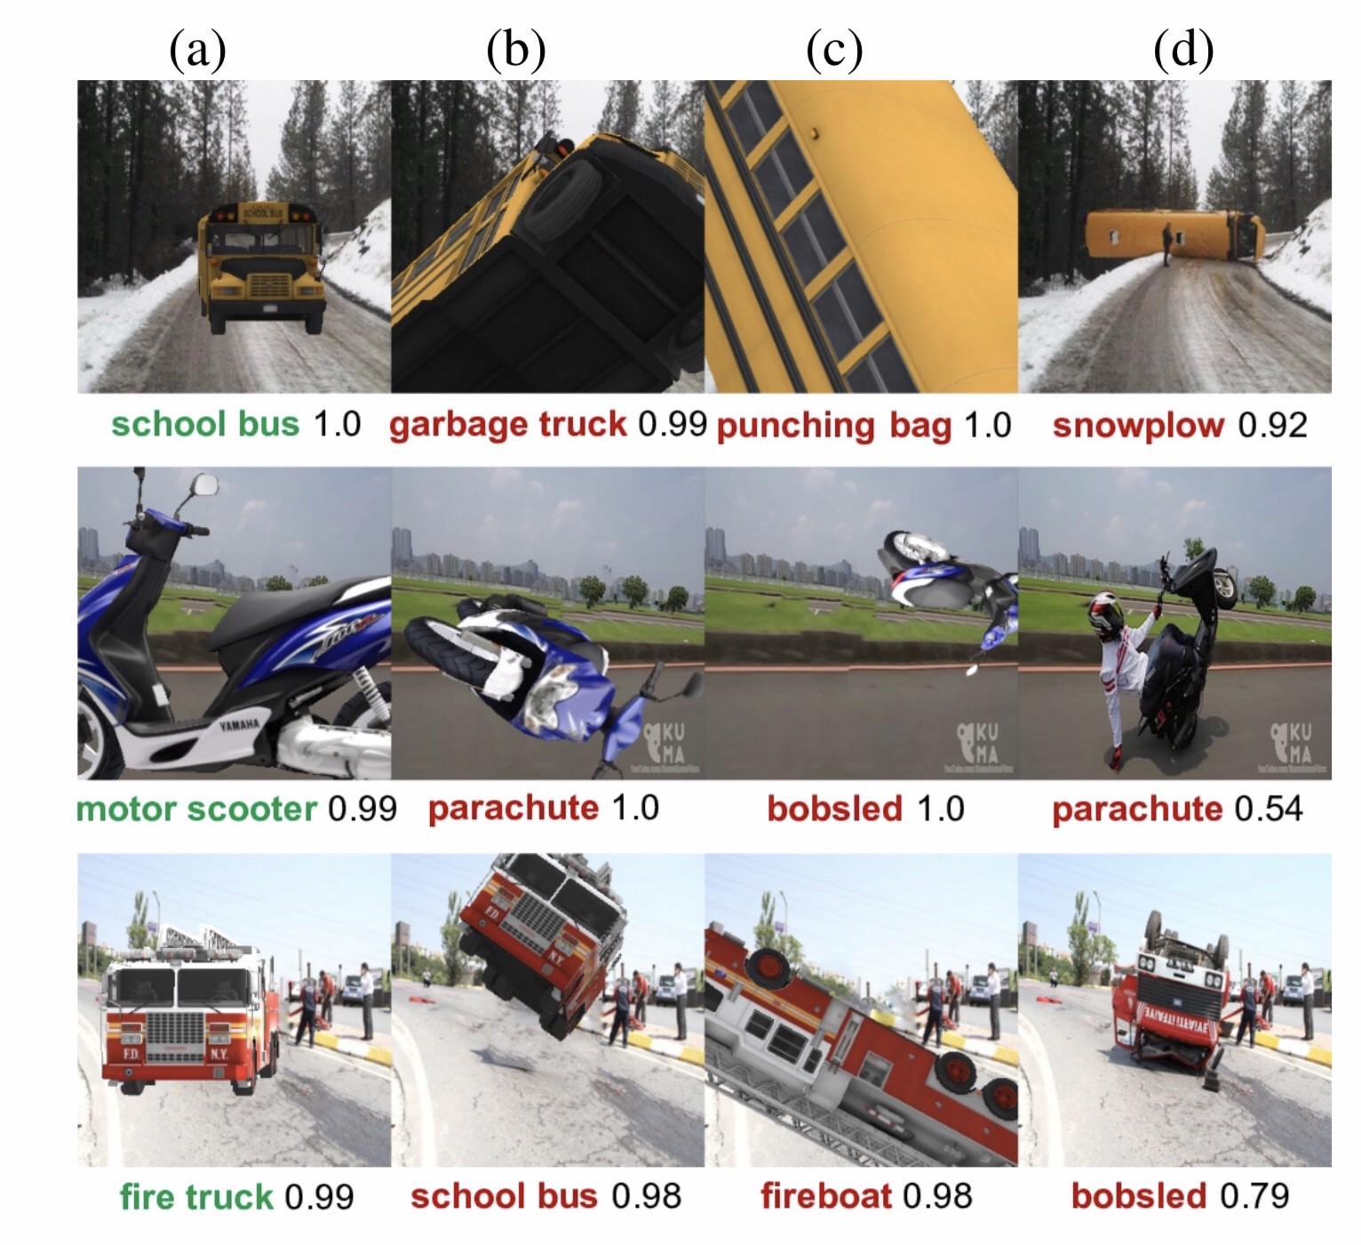
Problems - extrapolation

Slide 19
AsTHMATICS LESS LIKELY to die from pneumonia!
From the data,[1] the model learned that asthmatics are less likely to die from pneumonia.
The researchers traced the strange result back to an existing policy underlying the observed data: asthmatics with pneumonia were directly admitted to the intensive care unit (ICU), therefore receiving more aggressive treatment, and thus less likely to die than patients not given the same attention.
Caruana et al. Intelligible models for healthcare: predicting pneumonia risk and hospital 30-day readmission

Slide 20
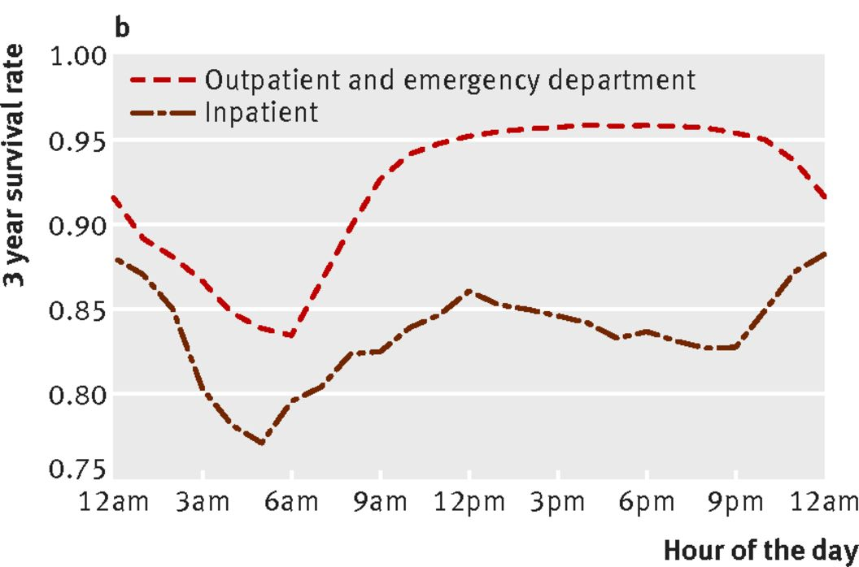
HOSPITAL PATIENTS ARE SICKER AT NIGHT!
Having a lab tests, regardless of any other information about the test result is strongly correlated to the odds of survival (at 3 years)
The time that the test is ordered is more accurate than the actual test result in predicting survival for 68% of test types

